Slide 1

Water Quality and Herbicides
Eric P. Prostko
Professor and Extension Weed Specialist
Department of Crop & Soil Sciences

Slide 2

A common question?
Should I use AMS with that?

Slide 3
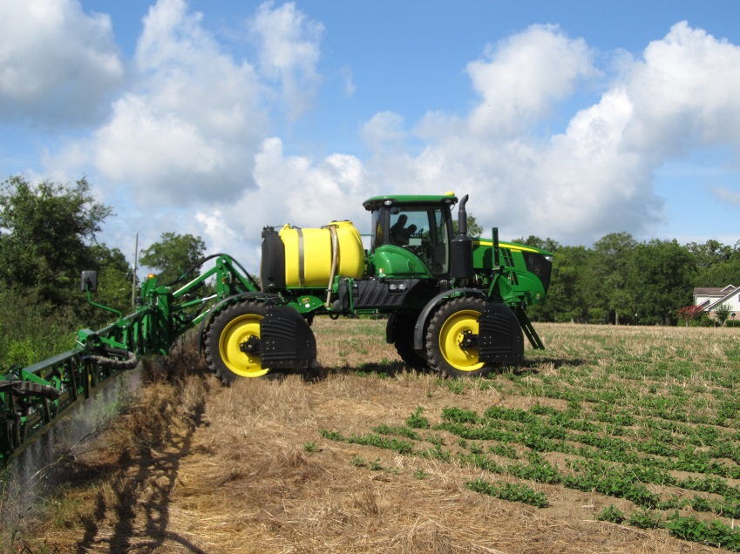
Important Water Qualities
turbidity
pH
hardness

Slide 4
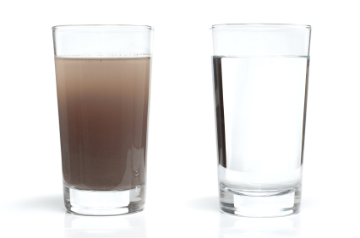
Turbidity
Suspended solids, soil, and OM
Can affect herbicides with high K_{oc} values
  Paraquat
  Glyphosate
Don’t use muddy water!
Herbicide | K_{oc} (mL/g)
paraquat | 1,000,000
glyphosate | 24,000
s-metolachlor | 200
atrazine glufosinate | 100
dicamba | 2

Slide 5
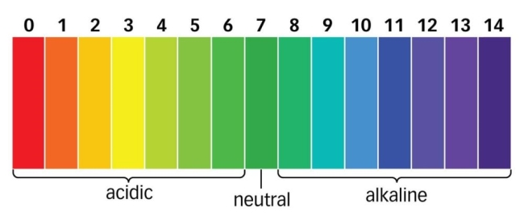
Water pH
Measurement of acidity/alkalinity
  <7.0 = acidic
  >7.0 = alkaline
  7.0 = neutral
4.0 to 7.0 is fine
Alkaline hydrolysis above 7

Slide 6
Alkaline Hydrolysis
Valor (flumioxazin)
Soil-Water Half-Life
  pH 5.0 = 3.4 to 5.1 days
  pH 7.0 = 21.4 to 24.6 hours
  pH 9.0 = 12.6 to 22.0 minutes

Slide 7
Water Hardness
Measure of cations (+) in solution
Ca, Mg, Fe, K, Na
Can influence the performance of weak acids
  glyphosate
  glufosinate
USGS Category | CaCO₃ (ppm)
Soft | 0-60
Moderately Hard | 61-120
Hard | 121-180
Very Hard | > 180
WHO Category | Total Hardness (ppm)
Soft | 0-114
Moderately Hard | 114-342
Hard | 342-800
Very Hard | > 800

Slide 8
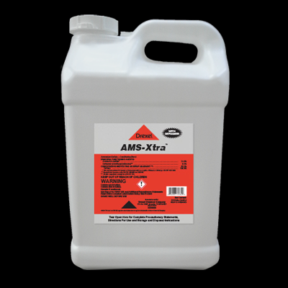
Ammonium Sulfate and Hard Water
(NH₄)₂SO₃
Overcomes antagonistic effects of cations
How?
  Lowers pH
  NH₄+ binds with herbicide
  SO₄- binds with cations
  8.5-17 lbs/100 gals (dry)
  2.5-5.0 gals/100 gals (liquid)

Slide 9
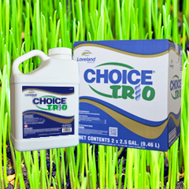

Water Conditioners
Helena
Non-AMS water conditioner
0.25%-0.50% v/v
~$24/gal
$0.60-$1.20/A – 10 GPA
CPS
Non-AMS water conditioner
0.25% to 0.50% v/v
~$34/gal
$0.85-$1.70/A – 10 GPA

Slide 10
In the absence of hard water, is AMS really needed?
RUP = Roundup
ATZ = Atrazine
LBY = Liberty
CAP = Capreno
SFQ = Steadfast Q
AMAPA
19 DAT
CN-10-13
AMS Xtra @ 2.5% v/v

Slide 11
In the absence of hard water, is AMS really needed?
Cadre 70DG 1.44 oz/A
COC @ 1% v/v
CASOB
PE-08-04
AMS 100 DF @ 3 lb/A

Slide 12
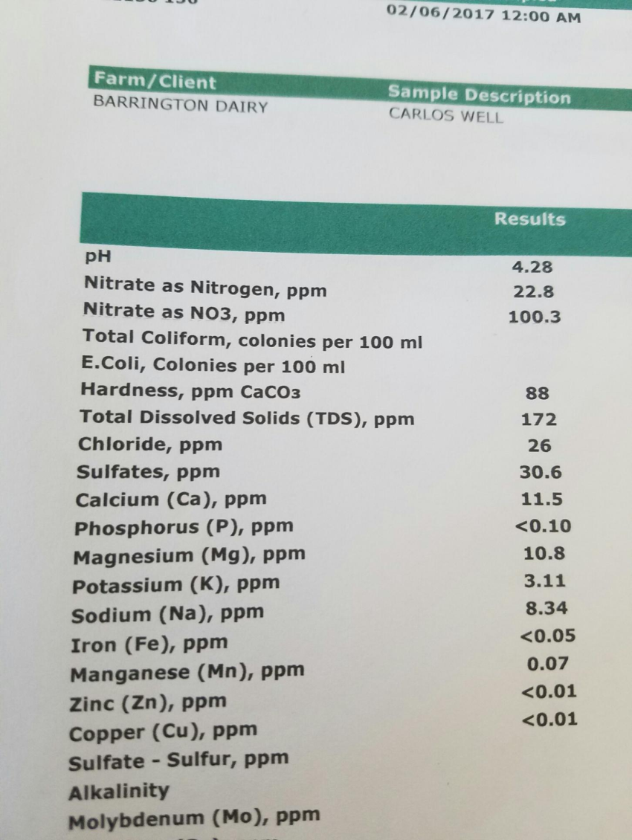
Sample Water Quality Report
pH = 4.28
Hardness = 88 ppm CaCO₃
  Moderately hard (USGS)
Using NDSU-AMS equation
    0.3 lbs AMS/100 gals

Slide 14
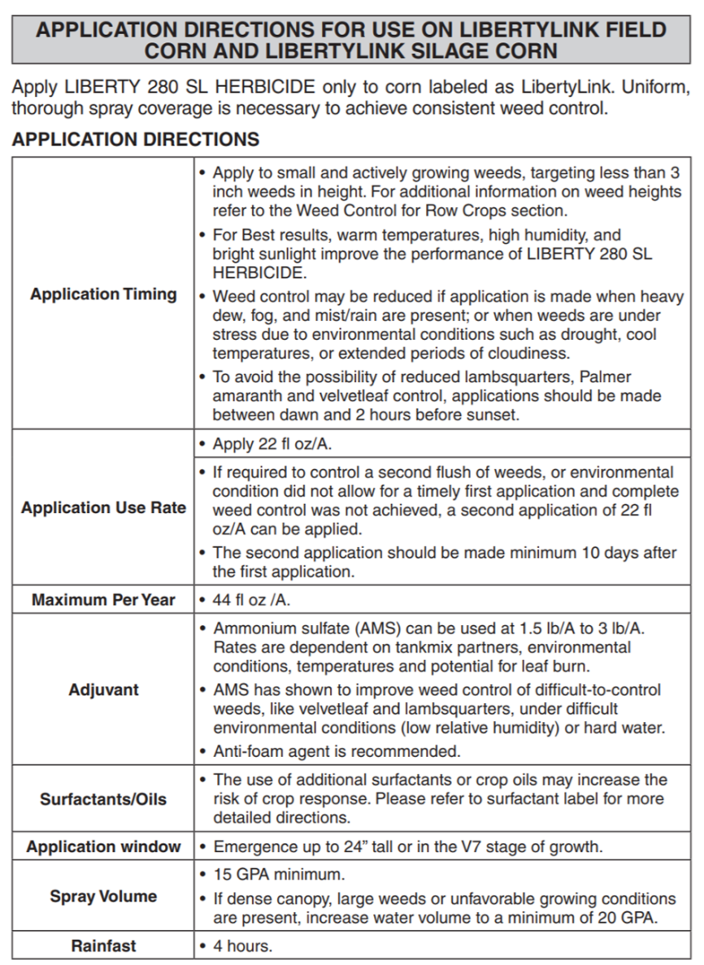
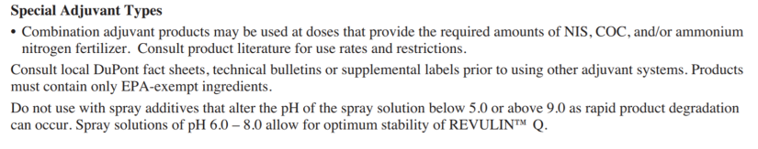
Check Labels

Slide 15
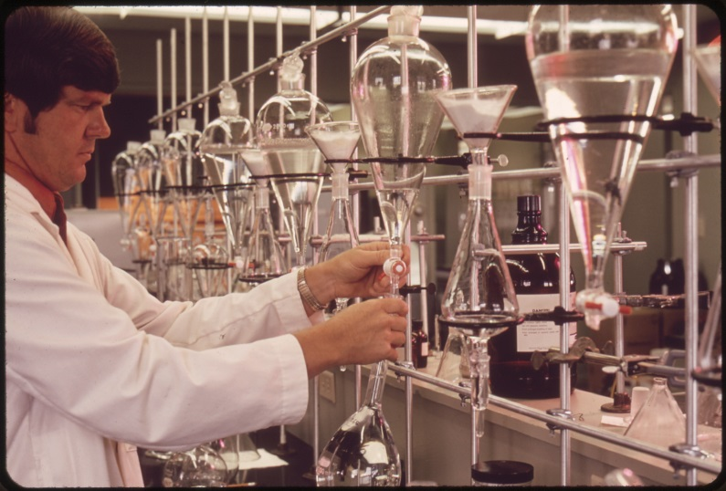
Water Testing Labs
UGA
  $20/sample
Waters Agricultural Lab
  $38/sample

Slide 16
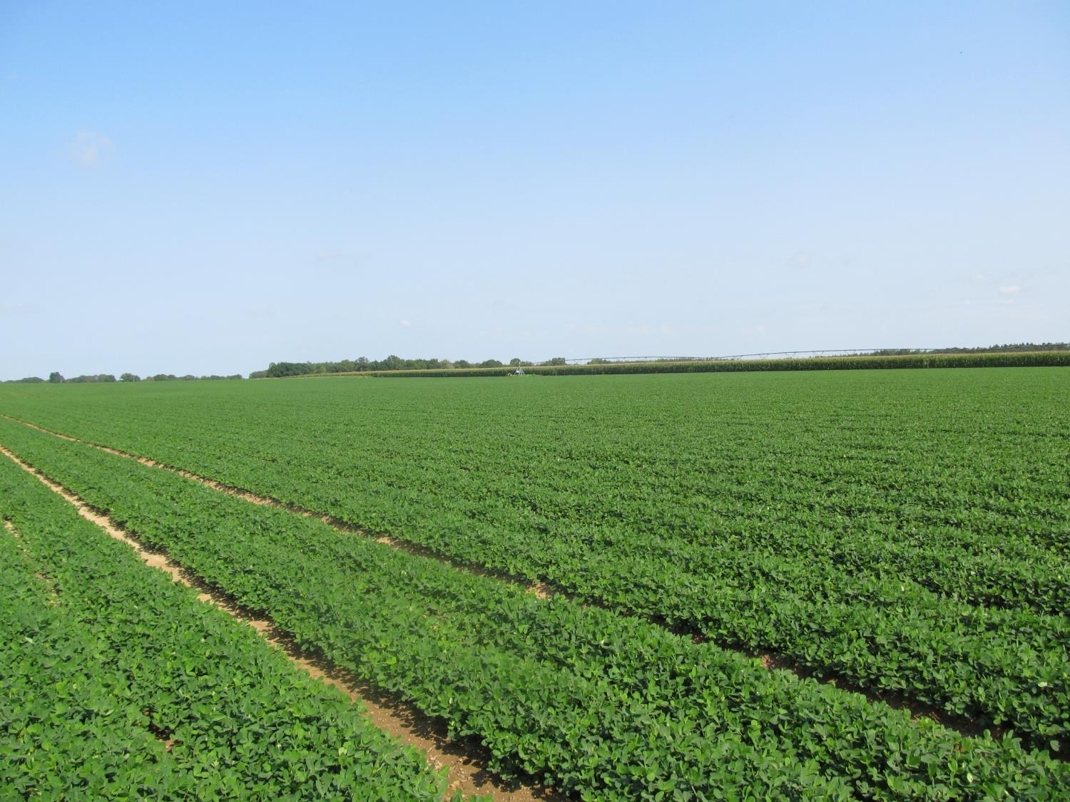
Questions?
eprostko@uga.edu
www.gaweed.com

